Slide 1
JOBS (poklici)

Slide 2
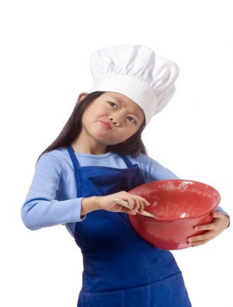
JOBS (poklici)
a cook kuhar/-ica
a teacher učitelj/-ica
a doctor zdravnik/zdravnica

Slide 3
JOBS (poklici)
a vet veterinar/-ka
a pilot pilot

Slide 4
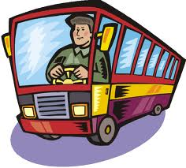
JOBS (poklici)
a policeman policaj
a postman poštar
a bus driver šofer/-ka
avtobusa

Slide 5
JOBS (poklici)
a baker pek
a singer pevec/pevka

Slide 6
JOBS (poklici)
an astronaut astronavt
a mechanic mehanik
a writer pisatelj/-ica

Slide 7
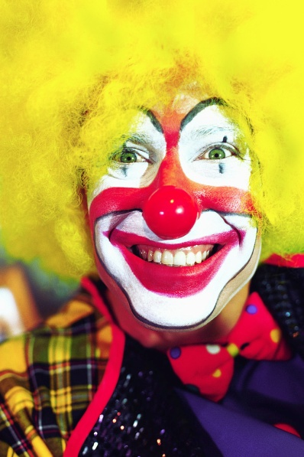
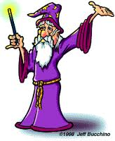
JOBS (poklici)
a clown klovn
a wizard čarovnik

